Slide 1
The Other Alex
Alex Shellum, Alex Malott, Aaron Thompson
Devin Kadillak, Lucas Wilson

Slide 2
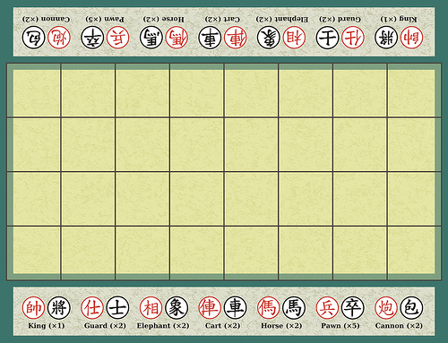
Banqi
• 32 pieces are place upside down at random on four by eight board.
•Two Players take turns
•flipping a piece
•moving their piece
•capturing an opponent's piece

Slide 3
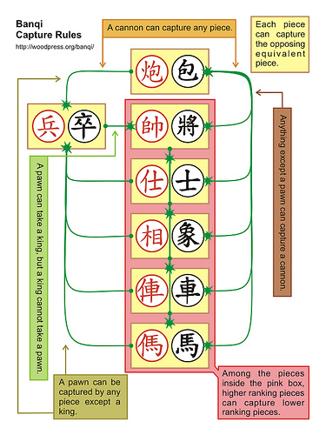
Banqi Capture Rules
The pieces are ranked with each piece able to capture equal or lesser pieces.
An exception to this rule are the soldiers, the lowest ranked piece, which can capture the highest ranked generals.
Cannons are the other exception to the rank rule: they can capture any piece including the general and can be taken by any piece except a soldier.

Slide 4
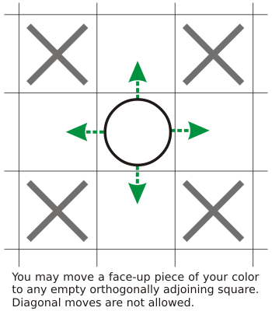
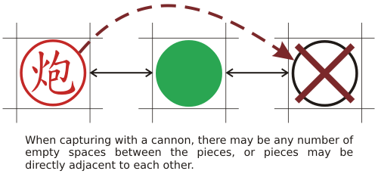
Banqi Movement

Slide 5
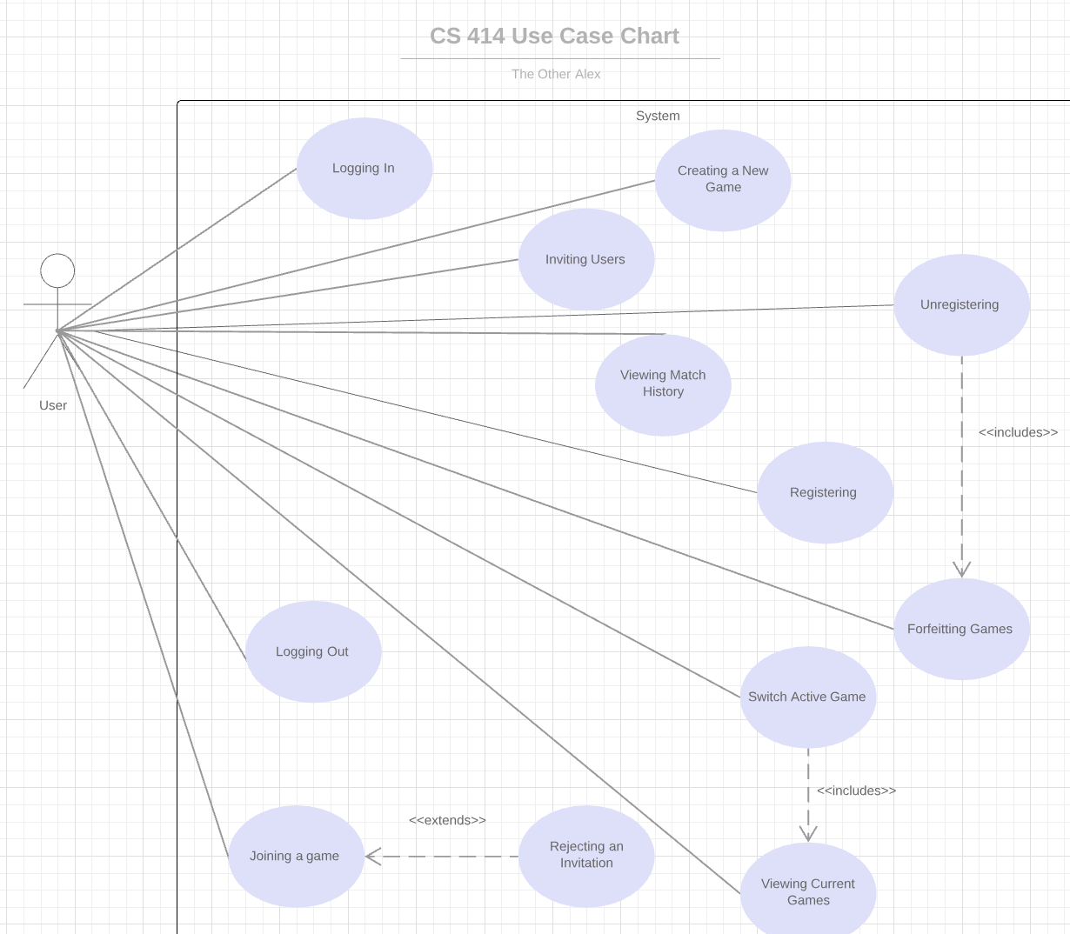
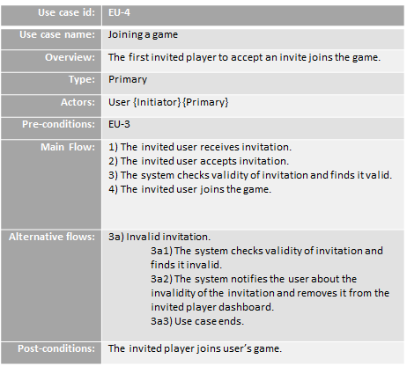
Use Case Document

Slide 6
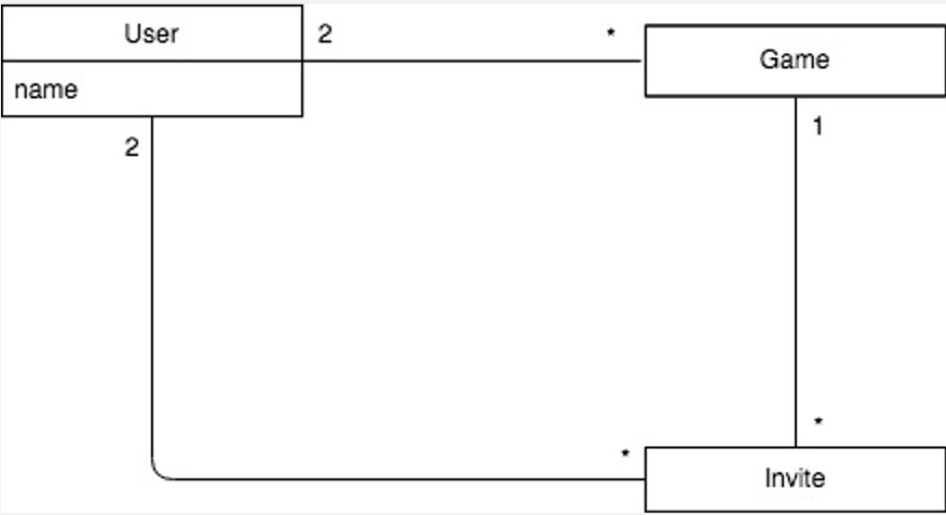
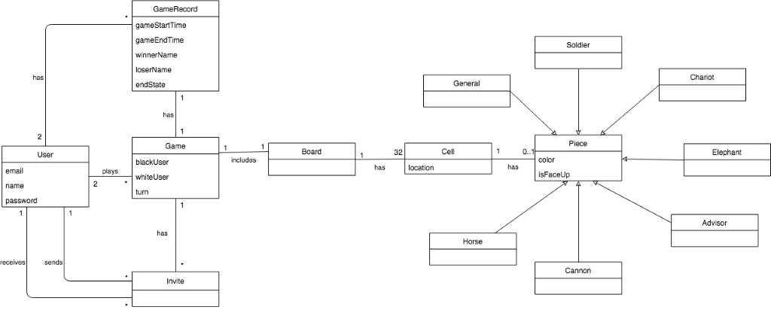
Domain Model
Old and busted
Revised

Slide 7
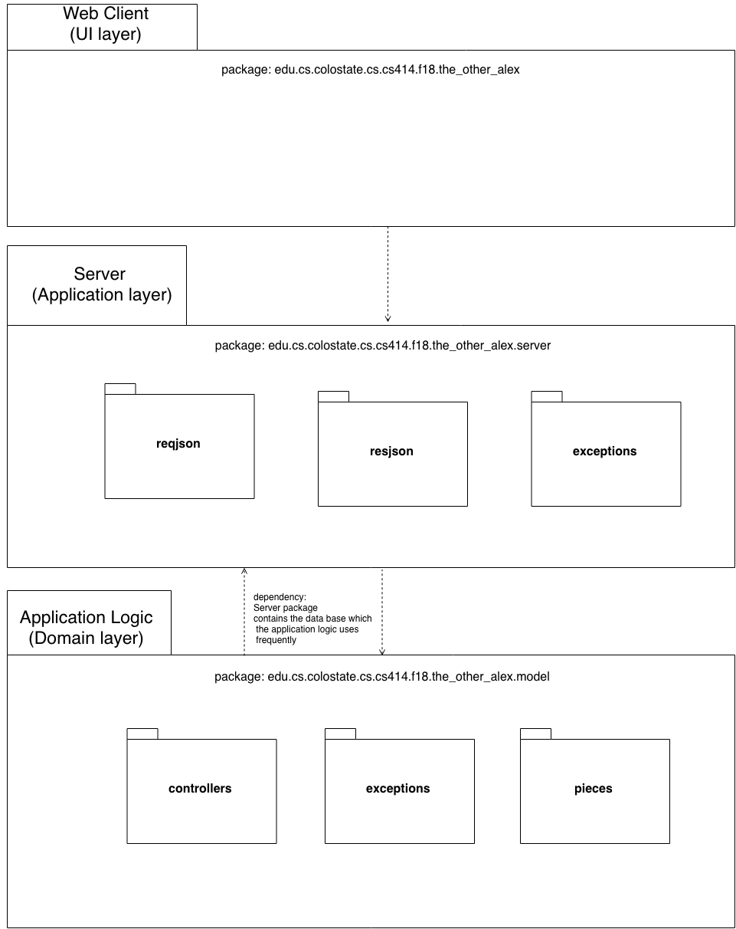
Design Document: Package Diagram

Slide 8
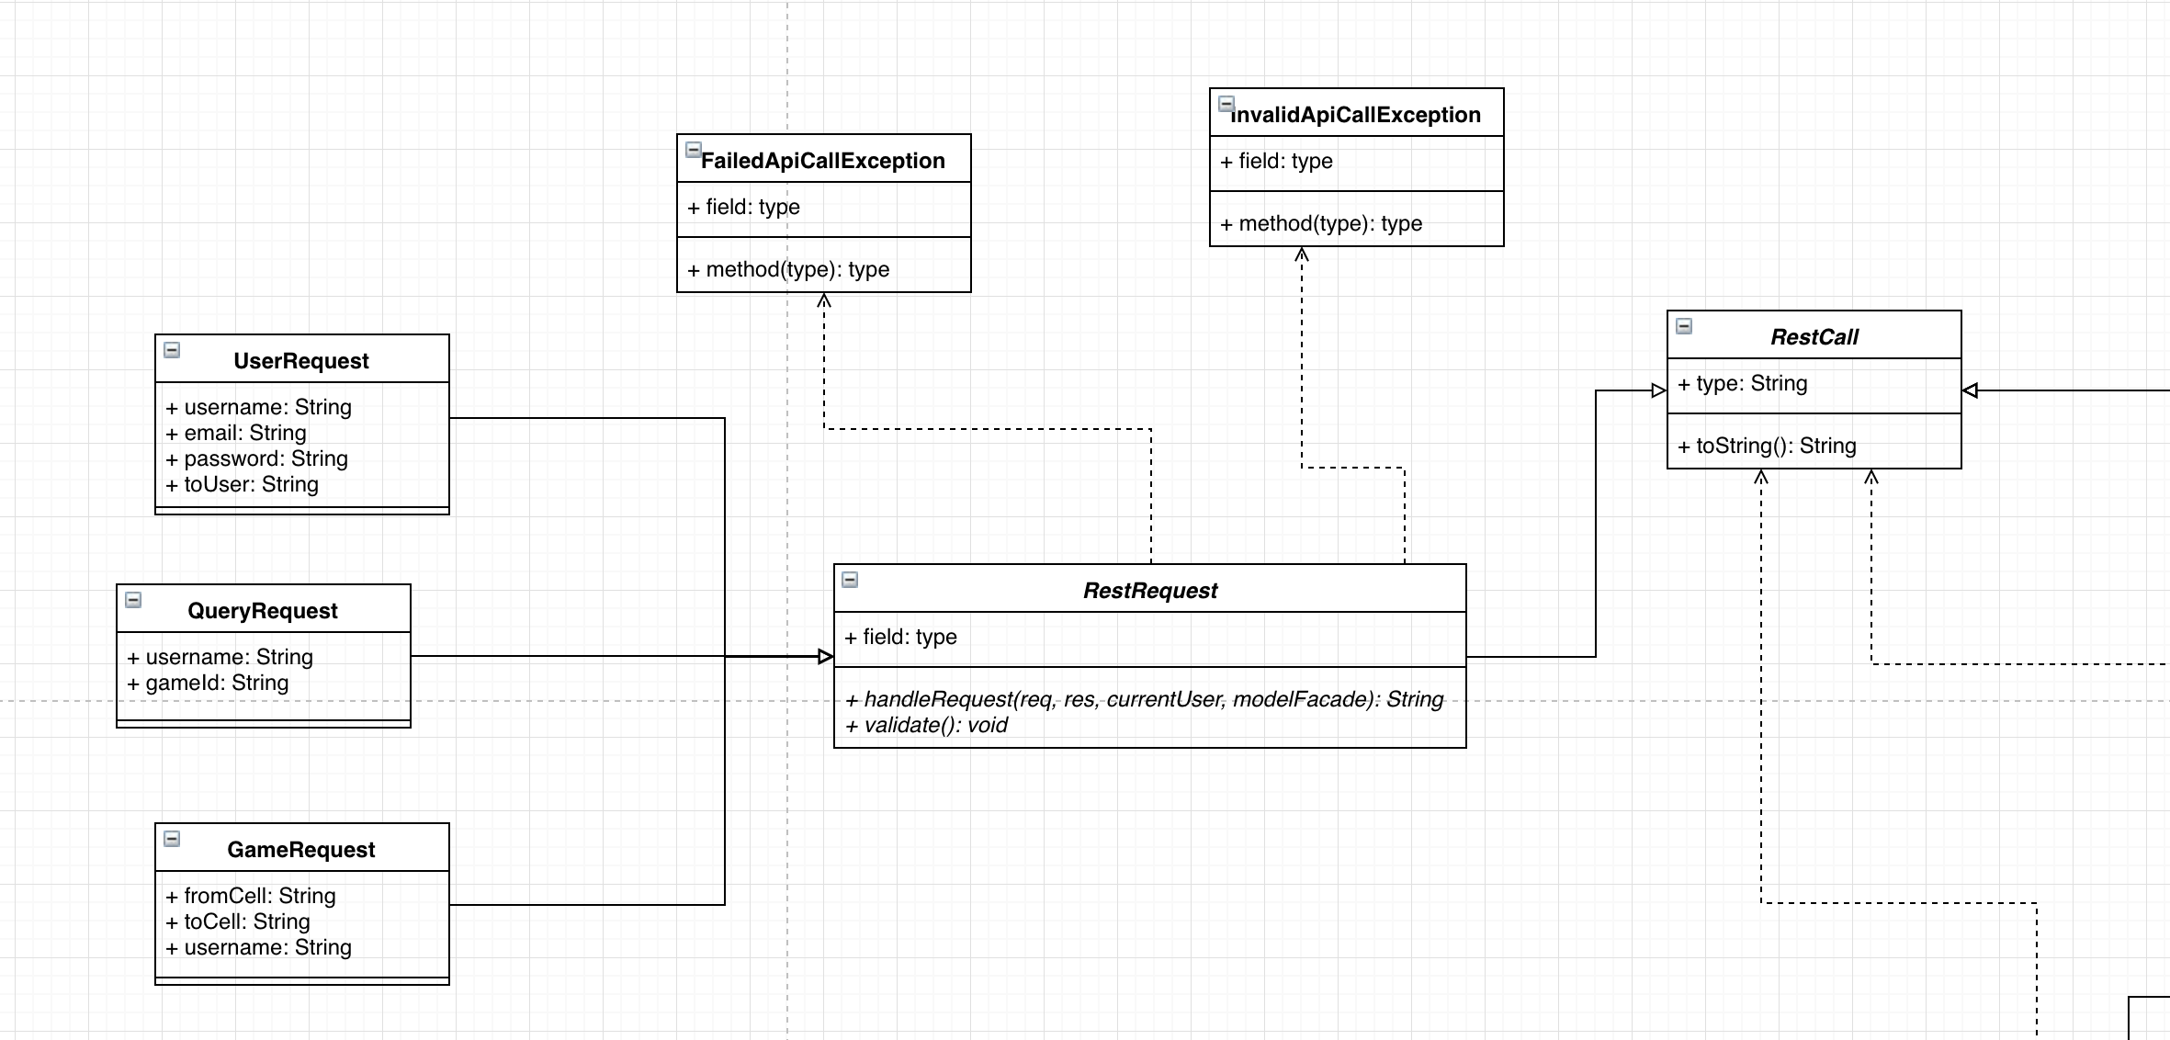
Design Document: Design Class Diagram

Slide 9
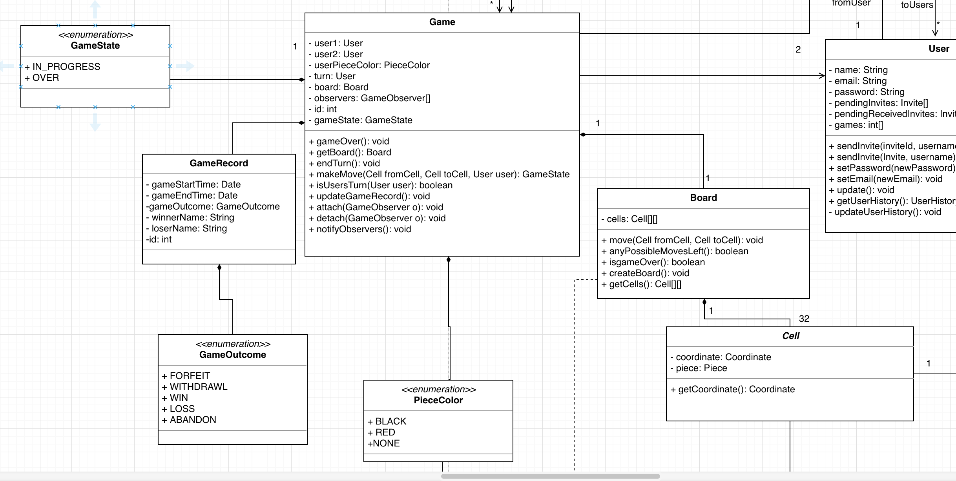
Design Document: Design Class Diagram

Slide 10
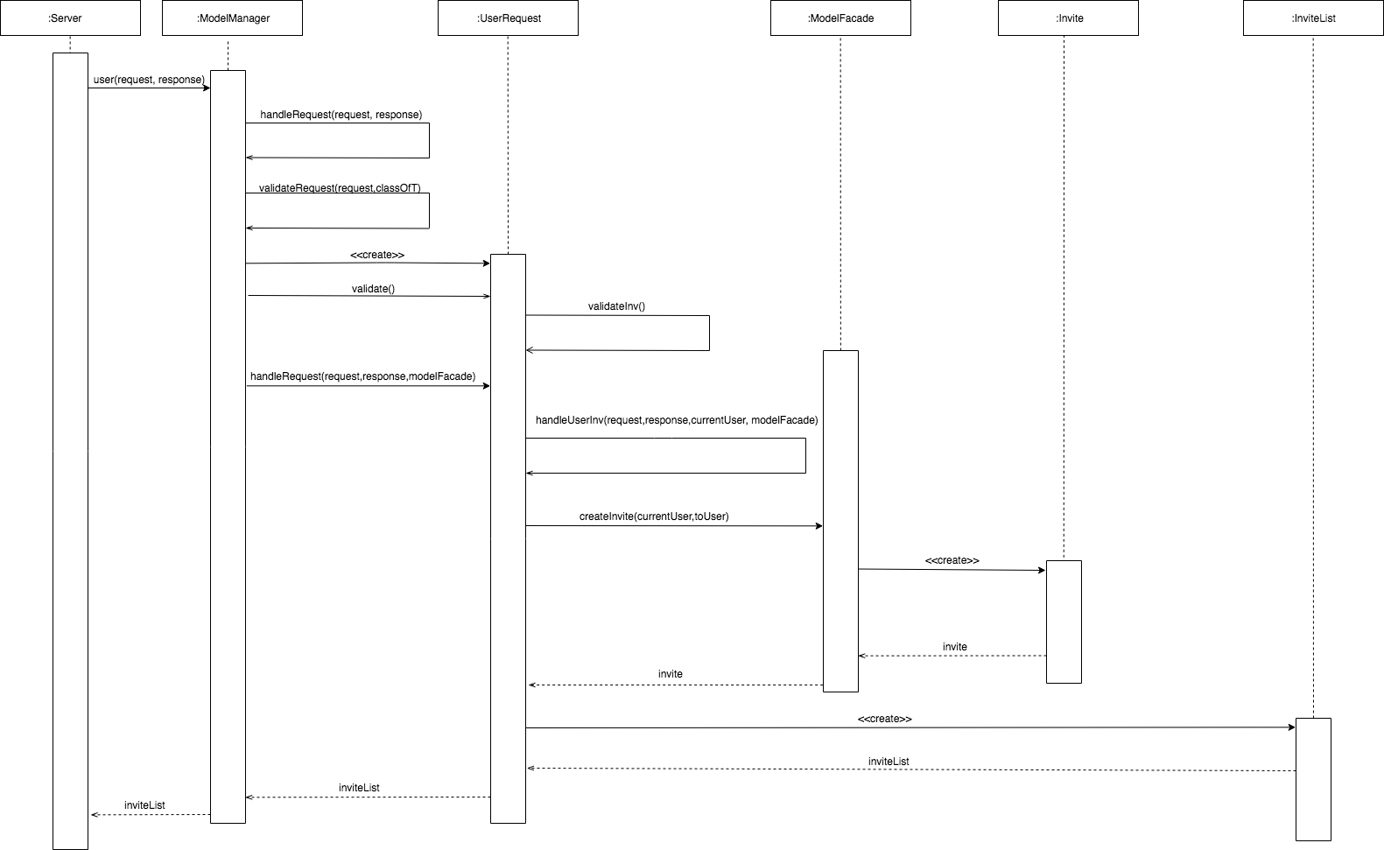
Sequence Diagram For Creating an Invite

Slide 11
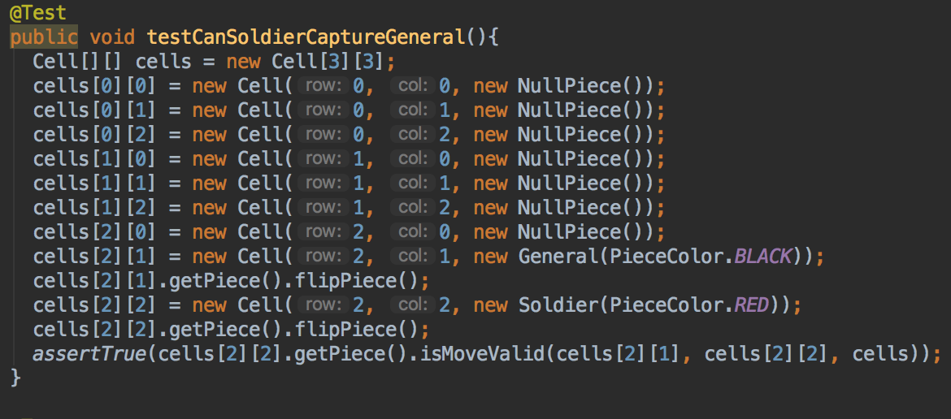
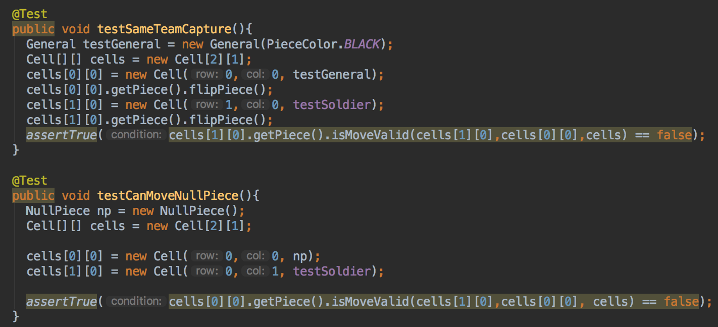
Unit Testing
Testing corner cases
Testing basic functionality

Slide 12
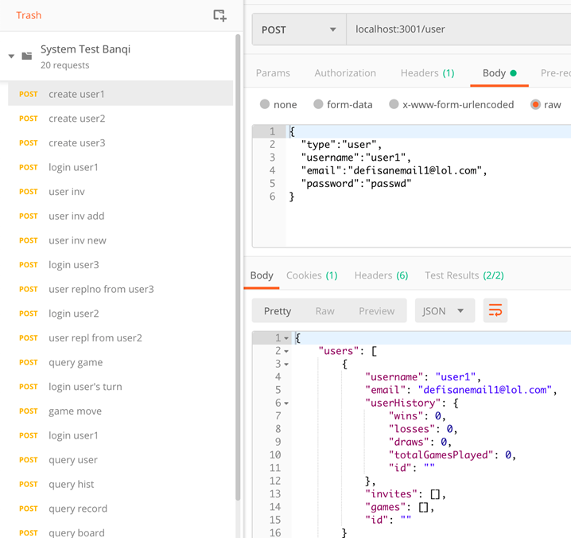
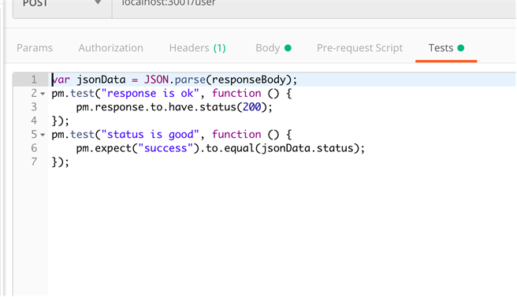
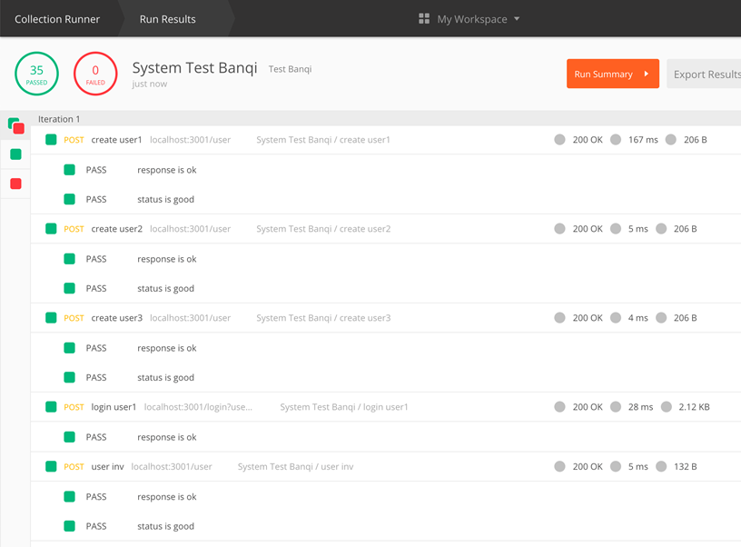
System Testing

Slide 13
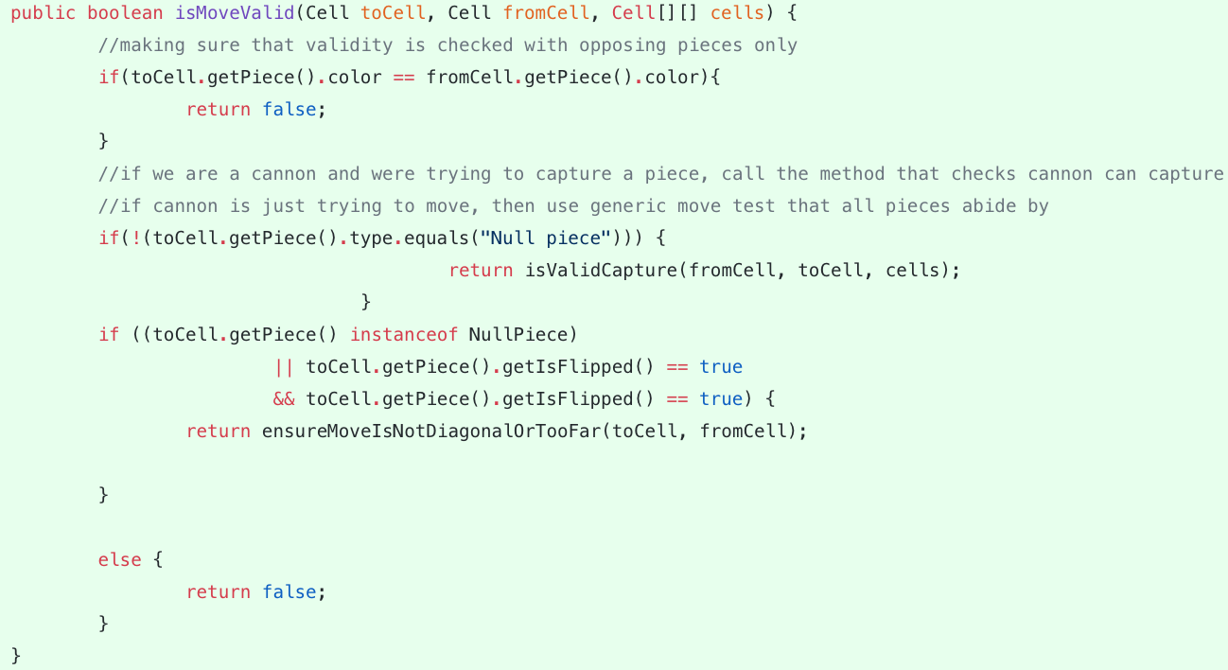
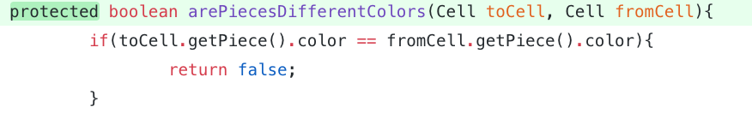
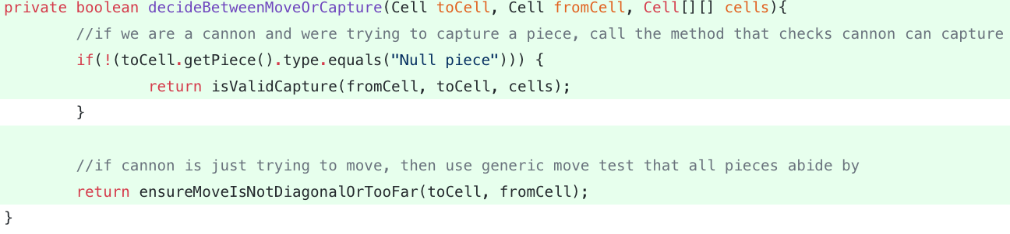
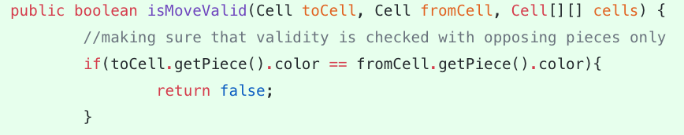
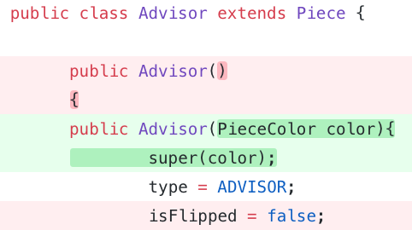
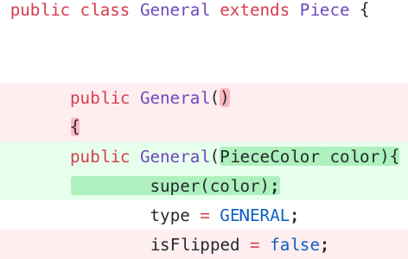
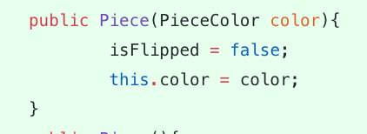
Refactoring
Sub class Cannon:
Pull up into Pieces:
Extracted into
Super class Piece:
Pulling up more:

Slide 14
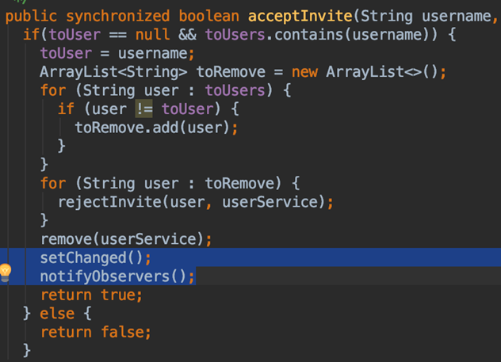
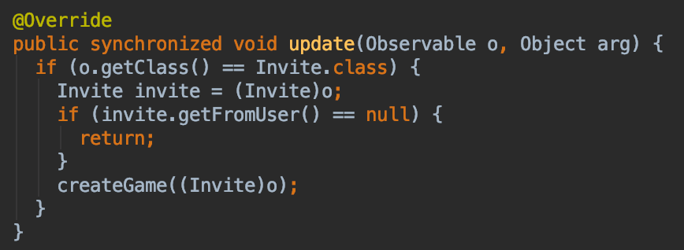
Pattern: Observer Pattern
The model controller observes Invites. When invites are accepted, a game is created.
Observer
Subject

Slide 15
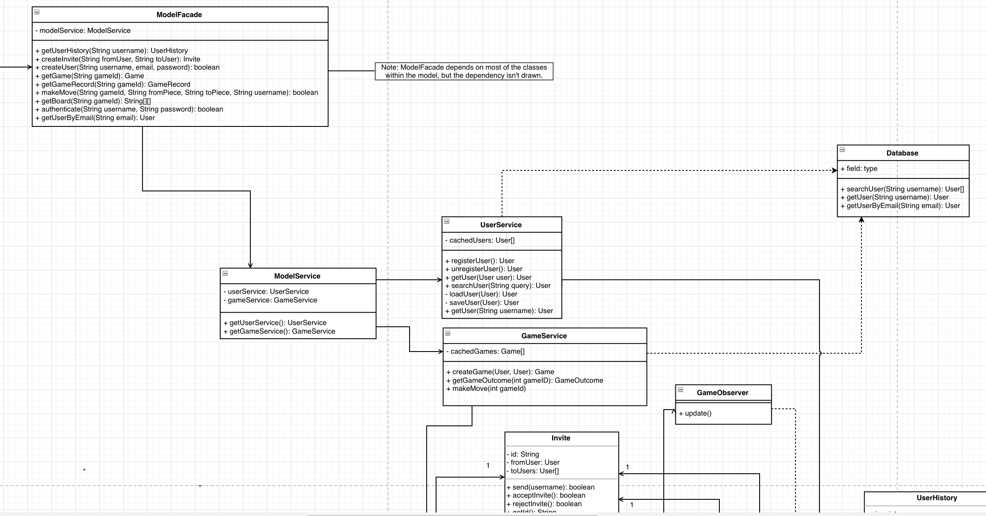
Pattern: Facade Controller

Slide 16
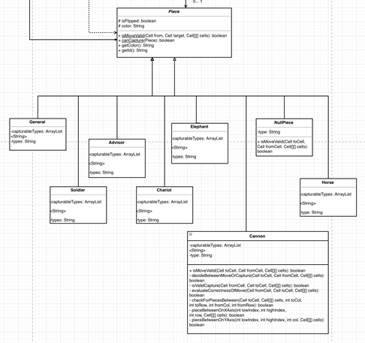
GRASP Pattern: Polymorphism

Slide 17
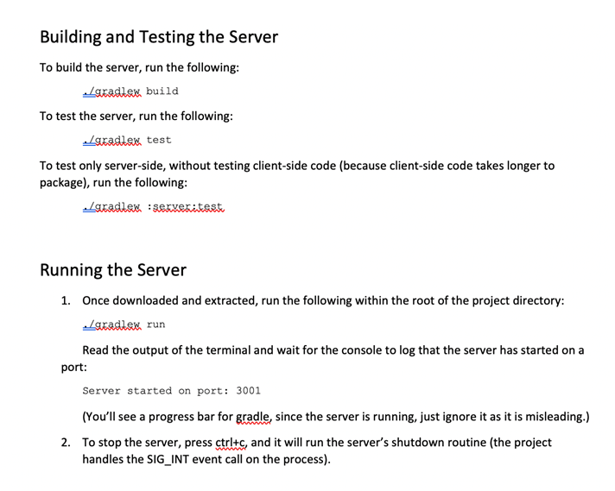
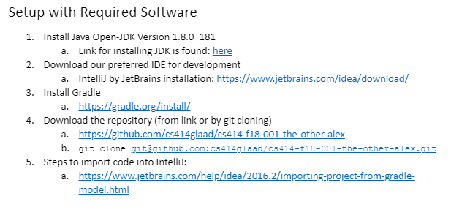
Development Manual

Slide 18
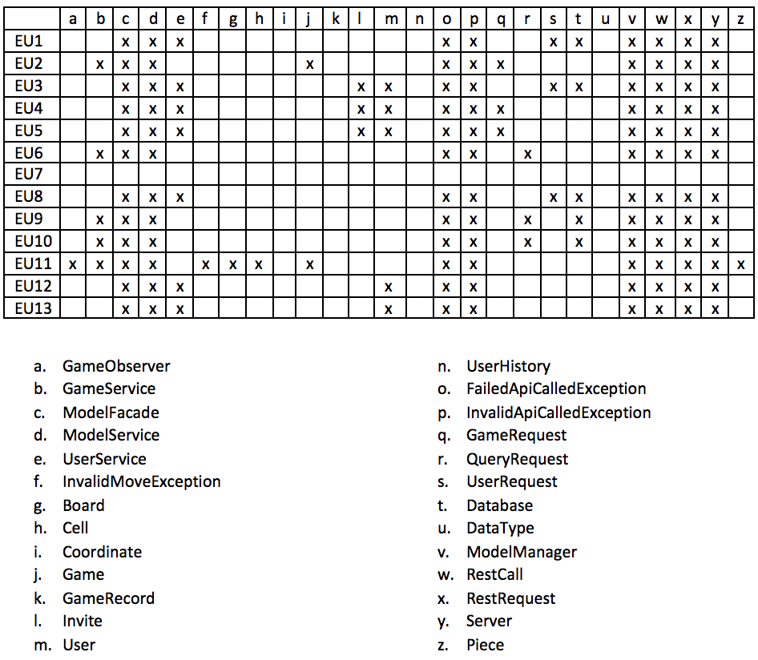
Traceability Link Matrix
EU1: Registering
EU2: Creating a game
EU3: Inviting Users
EU4: Joining a game
EU5: Rejecting Invitation
EU6: Switch active game
EU7: Forfeiting a game
EU8: Unregistering
EU9: Viewing match history
EU10: Viewing Active Games
EU11: Moving
EU12: Logging In
EU13: Logging out

Slide 19
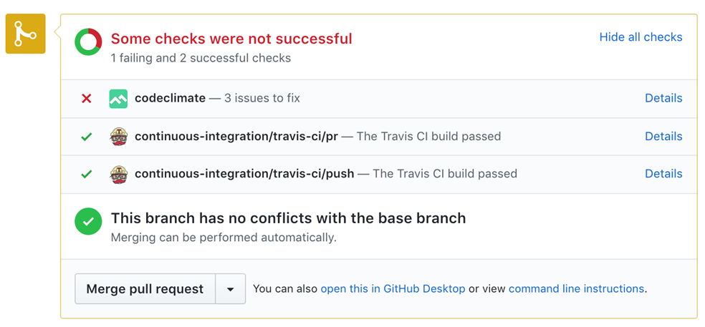
Technologies and Tools
IntelliJ and Eclipse (IDE)
HTML/React/Bootstrap (UI)
Spark (Server)
JUnit (Unit Testing)
MySQL (Database)
Git/GitHub (Version Control)
ZenHub (Task Management)
Slack/SMS (Communication)
Gradle (Build tool)
Code Climate (Code Quality)
Travis-CI (CI and Unit Testing)
Postman (System Testing)

Slide 20
Challenges and Lessons Learned
Working with new technologies like Gradle and React
A more consistent approach at creating issues within the repository
Breaking large tasks into smaller more manageable ones
Need for improved communication:
Communicating progress with assigned tasks
Delegating work
Asking for help when needed
Offering help when idle

